Slide 1

LibraryHub | Enchanted Library
LibraryHub | Enchanted Library is a modern, secure digital library management system designed to streamline library operations. It features role-based access, automated workflows, and real-time notifications, providing a comprehensive solution for managing digital libraries.
Deployed Link: http://35.154.224.206:9300/welcome

Slide 2
Technology Stack
LibraryHub is built on a robust and modern technology stack to ensure performance, security, and scalability.
Backend
Frontend
Database
Spring Boot, Java 17
Thymeleaf, HTML5, Tailwind CSS, JavaScript
MySQL 8.0
Security
Architecture
Testing
JWT Token, Role-Based Access Control
MVC Pattern
JUnit 5, Mockito
Email Service
Gmail SMTP Integration

Slide 3
System Architecture & Design
Our system design incorporates Object-Oriented Programming (OOP) principles and various design patterns to ensure a modular, maintainable, and scalable application.
OOPs Implementation
Design Patterns Implemented
Encapsulation: Protected data access via getters/setters.
Inheritance: Hierarchical user roles (Admin → Librarian → Guest).
Creational
Factory Pattern (User/Book objects), Singleton Pattern (Catalogue).
Polymorphism: Dynamic method binding for different user types.
Abstraction: Simplified interfaces for complex operations.
Structural
Facade Pattern (Unified Dashboard interface).
Behavioral
Command Pattern (Book return), Observer Pattern (Book restoration), Strategy Pattern (Due dates).

Slide 4




Core Features
LibraryHub offers a comprehensive suite of features to manage users, books, borrowing processes, and notifications efficiently.
User Management
Book Management
Multi-role system (Admin, Librarian, Guest)
CRUD operations for books
JWT-based authentication
Search and filter capabilities
Secure password reset
Availability tracking
Borrowing System
Notification System
Automated due date calculation
Email for registration, password reset, logins
Overdue notifications
Book borrowing confirmation
Return processing with Command Pattern
Return reminders and overdue alerts

Slide 5



Testing Strategy
Our rigorous two-layer testing approach ensures the reliability and robustness of LibraryHub, covering both business logic and API interactions.
Service Layer Testing
JUnit + Mockito for business logic and edge case validation.
Controller Layer Testing
API endpoint validation and request/response handling.
Mocking Strategy
Mockito for external dependencies, simulated email service, and isolated database operations.

Slide 6




Security Implementation
Security is paramount in LibraryHub, implemented through a multi-faceted approach to protect user data and control access.
JWT Token Authentication
Role-Based Access Control
Secure stateless sessions for enhanced protection.
Admin (full access), Librarian (management), Member (browsing/borrowing).
Password Encryption
Session Management
BCrypt hashing for robust password security.
Token expiration and validation for secure sessions.

Slide 7
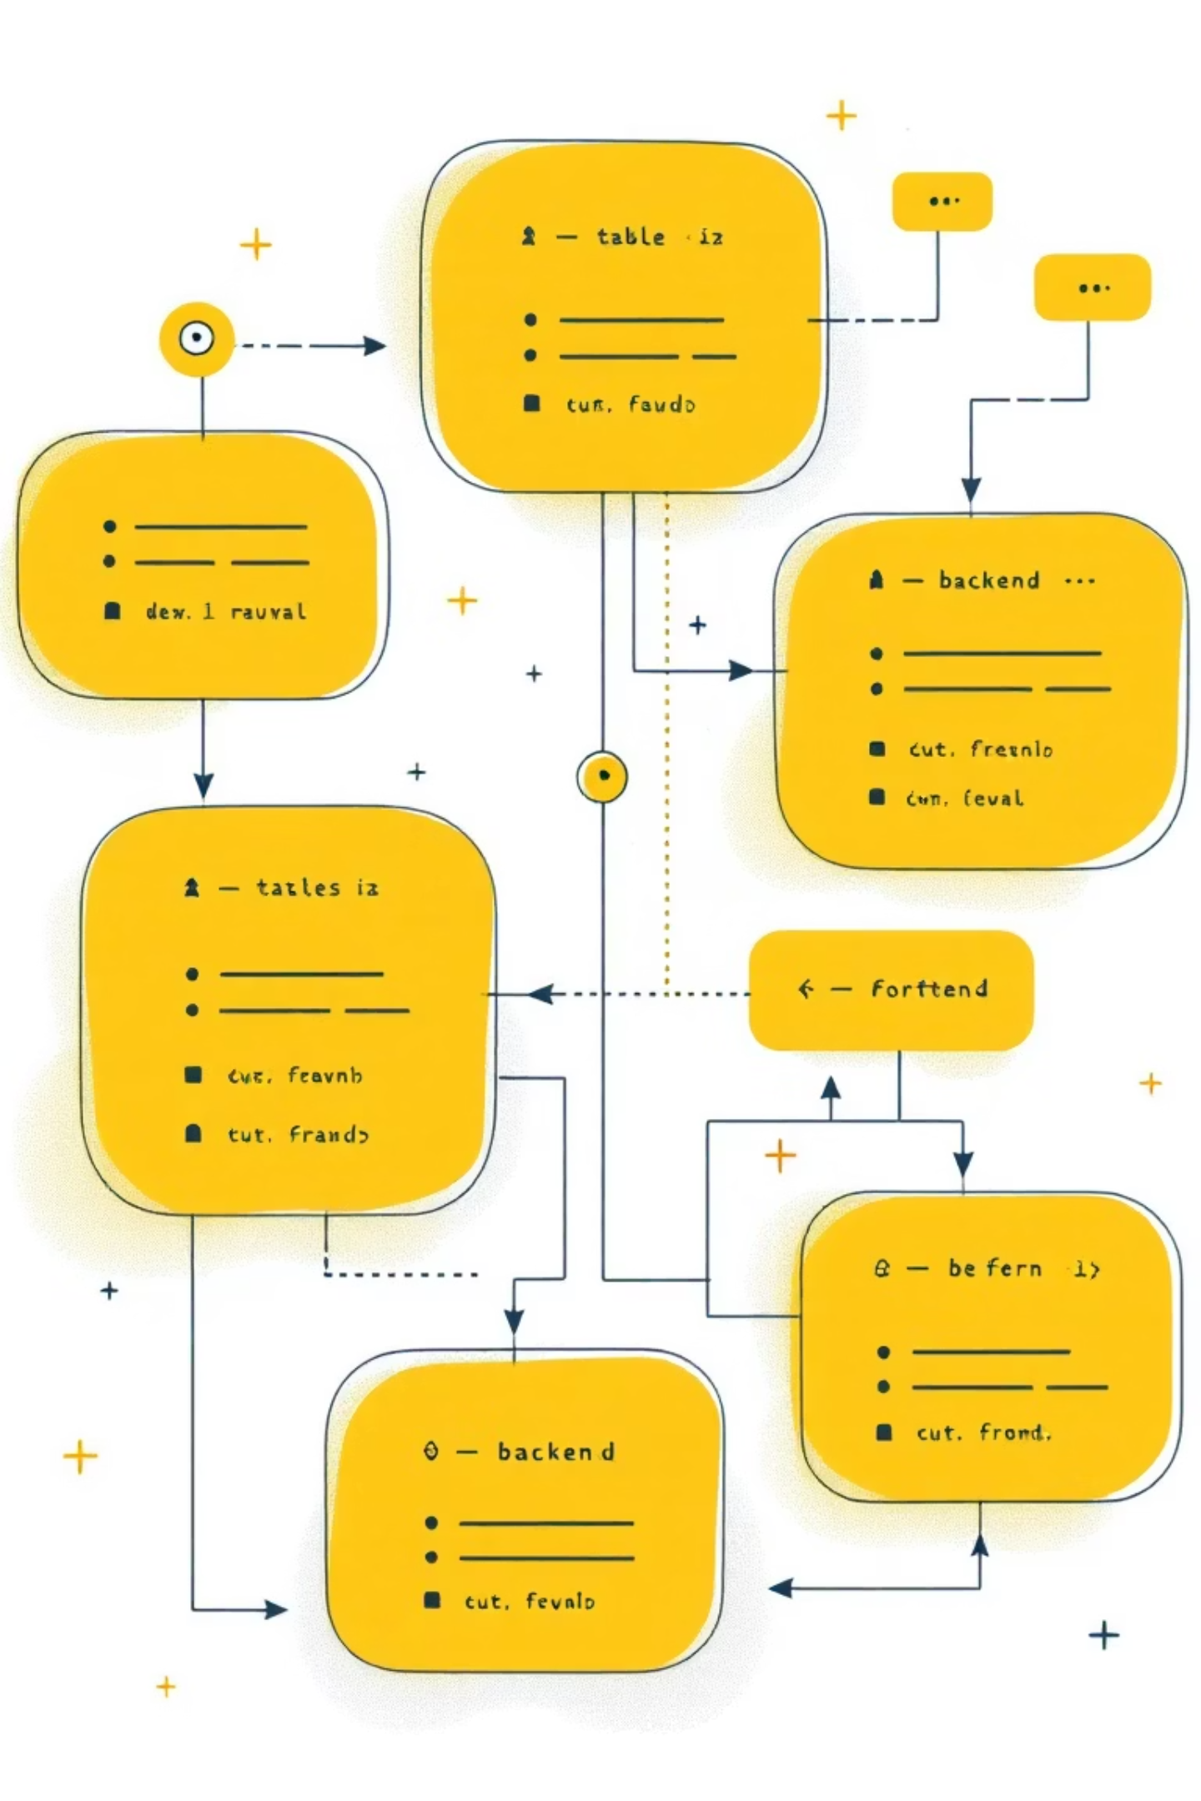
Key Components
LibraryHub is structured around distinct backend services, a user-friendly frontend, and a well-defined database schema.
Backend Services
Frontend Components
Database Schema
UserService: Factory pattern for user creation.
Responsive dashboard (Facade pattern).
Users table: Role differentiation.
Books table: Availability status.
BookService: Singleton catalogue for book management.
Real-time notifications.
Transactions table: Borrowing history.
User-friendly book browsing interface.
Notifications log.
Borrowing Service: Strategy pattern for due dates.
NotificationService: Observer pattern for alerts.

Slide 8


Deployment & Infrastructure
LibraryHub is deployed with a focus on high availability and scalability, ensuring a seamless user experience.
Server
Database
Spring Boot embedded Tomcat.
MySQL 8.0 for robust data storage.
Availability
Scalability
Stateless architecture for horizontal scaling.
24/7 uptime for continuous access.

Slide 9
Future Enhancements
We envision several exciting future enhancements to further enrich the LibraryHub experience and expand its capabilities.
1
2
3
Mobile Application
Advanced Analytics Dashboard
Digital Book Reader Integration
Develop a native app using React Native or Flutter.
Implement detailed usage statistics and insights.
Seamlessly integrate with e-readers for digital content.
4
5
Recommendation Engine
Social Features
Utilize Machine Learning for personalized book suggestions.
Add user reviews, ratings, and community interactions.

Slide 10
Conclusion
LibraryHub | Enchanted Library stands as a testament to robust design and comprehensive functionality.
Enterprise-Grade Architecture
Built with a solid MVC pattern.
Robust Security
Featuring JWT and RBAC for data protection.
Design Pattern Excellence
Over 6 patterns implemented for modularity.
Comprehensive Testing
A 2-layer approach ensures reliability.
Production Ready
Fully deployed and operational.
Professional Communication
Automated email system for user engagement.

